Slide 1



House Price prediction
Group 2:
Georgios Filippos Bogdos, Jesus Perez, Gideon Koech

Slide 2
Introduction and Problem Statement
Buying a real estate property can be stressful. Prices of real estate properties are linked with our economy.
There is still lack of accurate measures of house prices despite the vast amount of data available.
Our goal is to build Models that can accurately predict housing prices for different locations.
Traditional methods of housing price prediction, such as valuations by real estate agents, are often subjective.

Slide 3
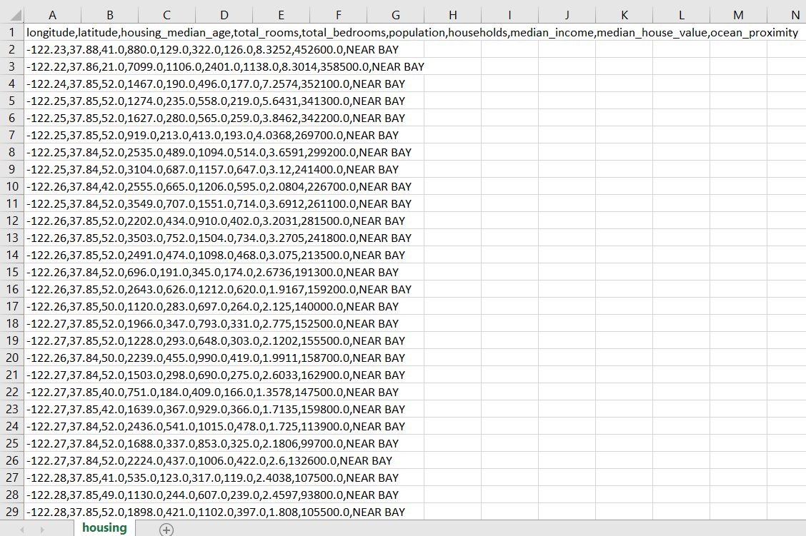
California Housing Dataset
California Housing dataset contains information on the housing prices in various districts in California.
The data set contains 20,640 instances with 8 features each. These features include Longitude, Latitude, median house value, median income, housing median age, total rooms, total bedrooms, population, households.
The median house value is the target variable in this dataset, with a range of values from $14,999 to $500,001.
The dataset is available at https://www.kaggle.com/datasets/camnugent/california-housing-prices

Slide 4
Algorithms
Linear Regression
Random Forest Regression
Gradient Boost Regression & Neural Networks
XAI

Slide 5
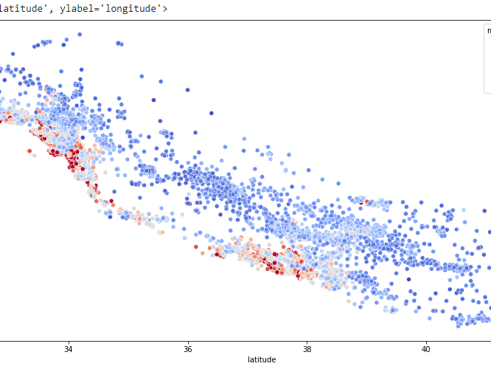
train data
sns.scatterplot
(x = "latitude",
y = "longitude",
data = train_data,
hue = "median_house_value",
palette = "coolwarm")

Slide 6
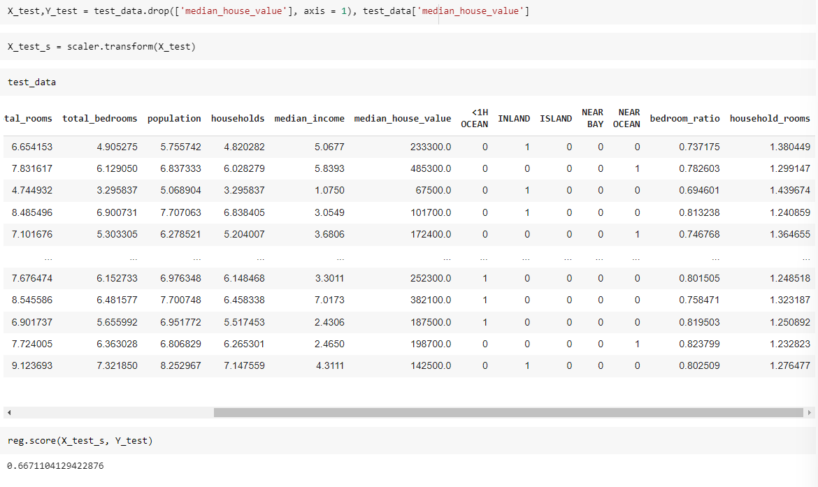
Linear regression Model
Linear regression is the most basic and commonly used predictive analysis. Regression estimates are used to describe data and to explain the relationship.
After data preprocessing, the Linear Regression Model is created then train the model using the training set we created
Accuracy of model was 0.6671104129422876

Slide 7
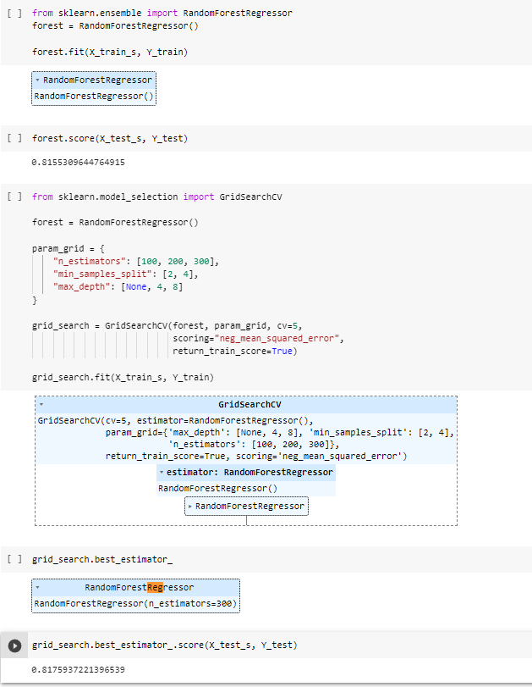
Random forest regression
A random forest is an estimator that fits a number of classifying decision trees on various sub-samples of the dataset and uses averaging to improve the predictive accuracy and control over-fitting
More powerful model than Linear Regression.
A special kind of Machine Learning that combines decisions trees.
Used hyper parameter tooling to find the optimal model
Used GridSearchCV from sklearn. It runs through all the different parameters that is fed into the parameter grid and produces the best combination of parameters, based on a scoring metric
Accuracy of model was 0.8175937221396539

Slide 8

Other Researched Options
For future implementation and to continue comparing our models we researched the following:
Gradient boost regression
Neural networks
Notes:
Gradient Boost Regression- variants of ensemble methods where you create multiple weak models and combine them to get better performance as a whole.
Neural Networks- forecasting methods that are based on simple mathematical models of the brain. They allow complex nonlinear relationships between the response variable and its predictors.

Slide 9
Data analysis
Data Exploration
Data Preprocessing
Feature Engineering

Slide 10
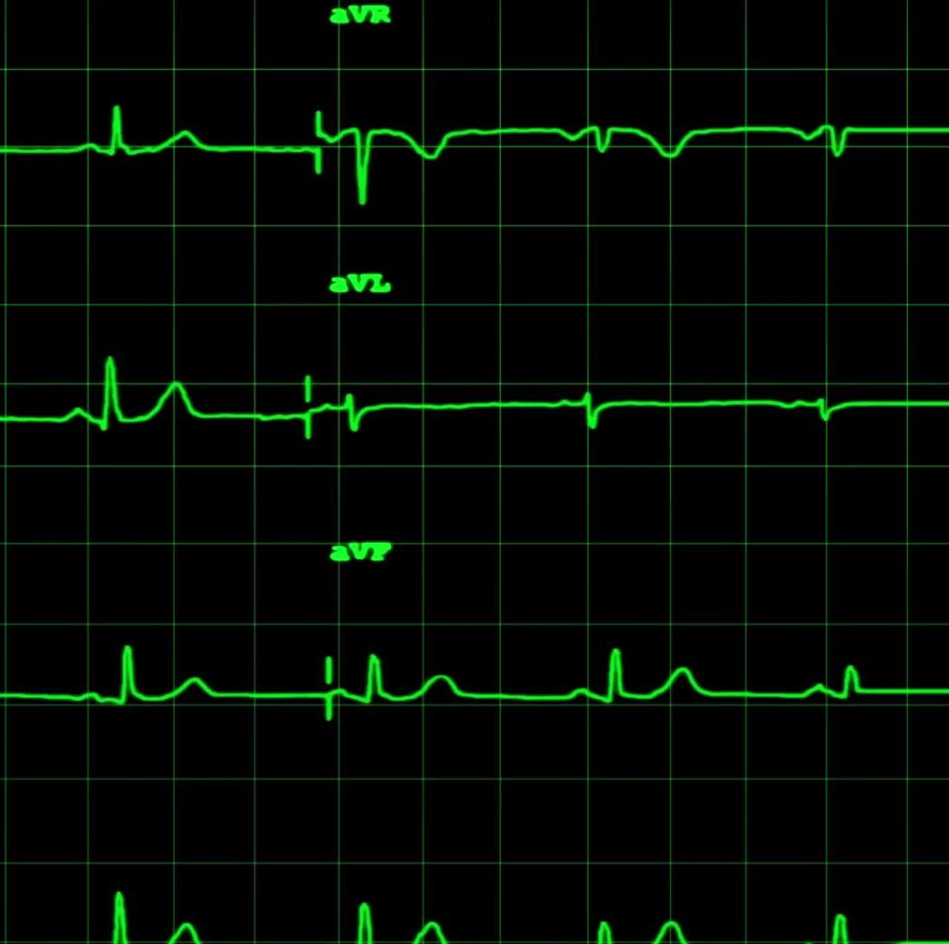
evaluation
The coefficient of determination (R²) - A number between 0 and 1 that measures how well a statistical model predicts an outcome. You can interpret the R² as the proportion of variation in the dependent variable that is predicted by the statistical model.

Slide 11
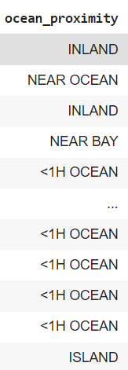

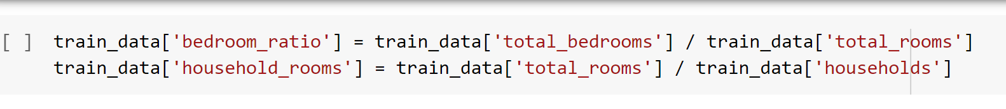
challenges

Slide 12

Our Novel Idea – XAI

Slide 13
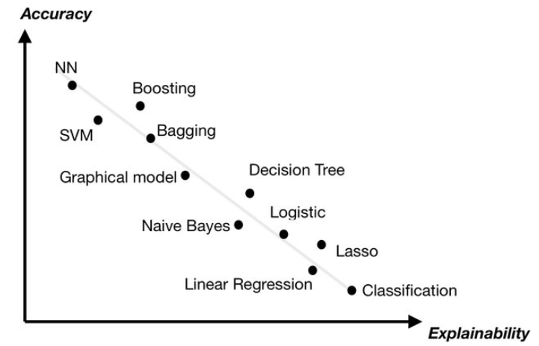
OUR NOVEL IDEA – XAI
Explainable AI (XAI) is an area of artificial intelligence (AI) research that focuses on creating AI systems that can explain their decisions and behaviors.
XAI seeks to create AI systems that are more transparent, interpretable, and accountable. This is important for ensuring that AI systems are used responsibly and ethically.
XAI techniques such as feature importance, partial dependence plots, and counterfactual explanations can help to explain the decisions made by AI systems and provide insights into how they work.

Slide 14

References
Prasad, K. Venkata, and K. Ravindra. "A comparative study of regression models for prediction of house prices in Ames, Iowa." Journal of Construction Engineering and Management 138, no. 4 (2012): 499-508.
Singh, R. K., and S. Singh. "Predicting housing prices with machine learning techniques." International Journal of Computer Applications 173, no. 7 (2017): 1-7.
Soni, N. K., and N. P. Goyal. "Housing price prediction using machine learning techniques: A review." arXiv preprint arXiv:1809.06354 (2018).

Slide 15
Thank you

